Slide 1
Risk Management Lessons From Long-term Capital Management
philippe jorion
Graduate School of Management, University of California at Irvine
Present by Shan SUN

Slide 2
Agenda
Overview of the LTCM saga
Reviews on how VaR can be used to assess the capital base needed to support a leveraged portfolio
Risk management practices of LTCM
A stylized example of a portfolio optimization with two highly correlated assets
Problem with portfolio optimization
LTCM’s risk profile
Conclusion

Slide 3
The LTCM Strategy
Core strategy: ‘relative-value’ / ‘convergence-arbitrage’ trade, trying to take advantage of small differences in prices among closely related securities.
Short on the run treasury bond & long off the run
Long MBS & short government
Long high-yielding (Italian, Greece, Russian) & short low-yielding (German)
The key is that eventually the two bonds must converge to the same value.
High leverage. High fees. The ’lockup’ clause.

Slide 4
How LTCM Lost Its Capital?
Founded in 1994 by John Meriwether, who left the Salomon Brothers after the 1991 Salomon bond Scandal.
The strategy worked excellently for LTCM in 1995 and 1996, with after-fees returns above 40%.
By 1997, the capital grew from $1 billion to more than $7 billion. The leverage ratio was 25:1.
In 1997, the fund return was down to 17% due to the narrowing of spreads, and LTCM returned $2.7 billion of capital to investors to get greater leverage. The leverage ratio went to 28:1.
In May and June of 1998, downturn in MBS market led to 16% loss in LTCM capital, which dropped from $4.7 to $4.0 billion, increasing leverage ratio to 31.

Slide 5
How LTCM Lost Its Capital?
On 17th August, Russia defaulted on its debt. LTCM lost $550 million on 21st August alone.
By August, the fund lost 52% of its 31st December value, leverage ratio increased to 55:1. Meriwether wrote to investors to ask for additional capital. No takers.
On 21st September, the fund lost another $550 million, mostly due to increased volatility in equity markets. Faced with margin calls.
On 23rd September, the New York Federal Reserve organized a bailout of LTCM. 14 banks invested $3.6 billion in return for 90% stake in the firm.
By the end of 1999, all of the money had been paid back to investors and Meriwether started a new hedge fund.

Slide 6
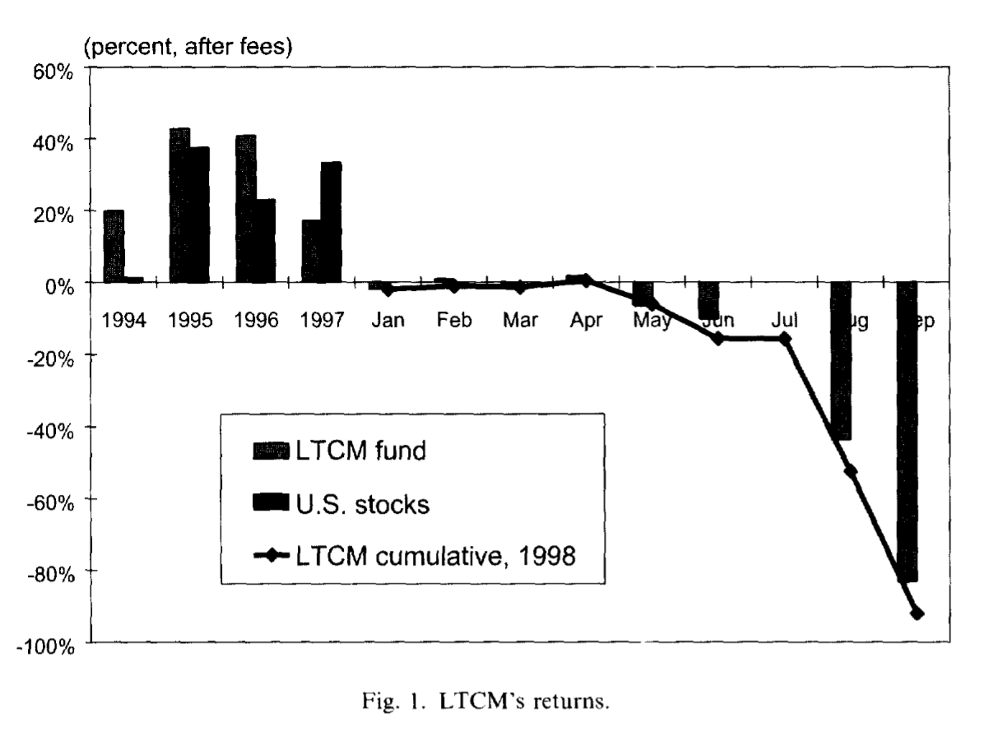

Slide 7
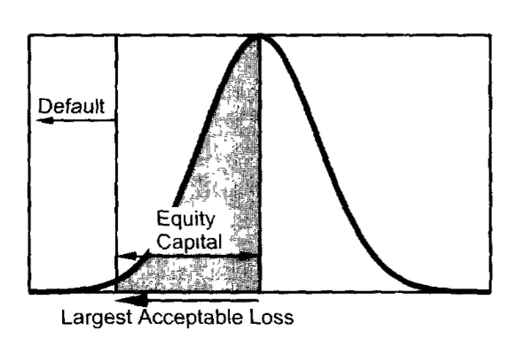
VaR and Equity Capital
Definition: the worst loss that can happen under normal market conditions over a specified horizon at a specific confidence level.
Uses: (1) practical first-order gauge of financial risk, to communicate risks to stakeholders.
(2) common benchmark to compare and control risk across risk-taking units.
(3) decide on the amount of equity capital necessary to support a trading activity.

Slide 8
VaR Viewed As A Measure Of ‘Risk Capital’
Only one investment---a futures position. This capital is leveraged.
Notional value of $100 million, margin of $10 million, payoff of $5 million
What is the rate of return on this investment?
Suppose for instance that VaR is estimated to be $20 million at the 99% level. It is interpreted as the largest acceptable loss the bank is willing to suffer over a specified period. So $20 million is the amount of equity capital that the bank need to maintain as a self-insurance.
Rate of return = $5/$20 = 25%
With a lower capital base, the rate of return would be even higher, more risky.

Slide 9
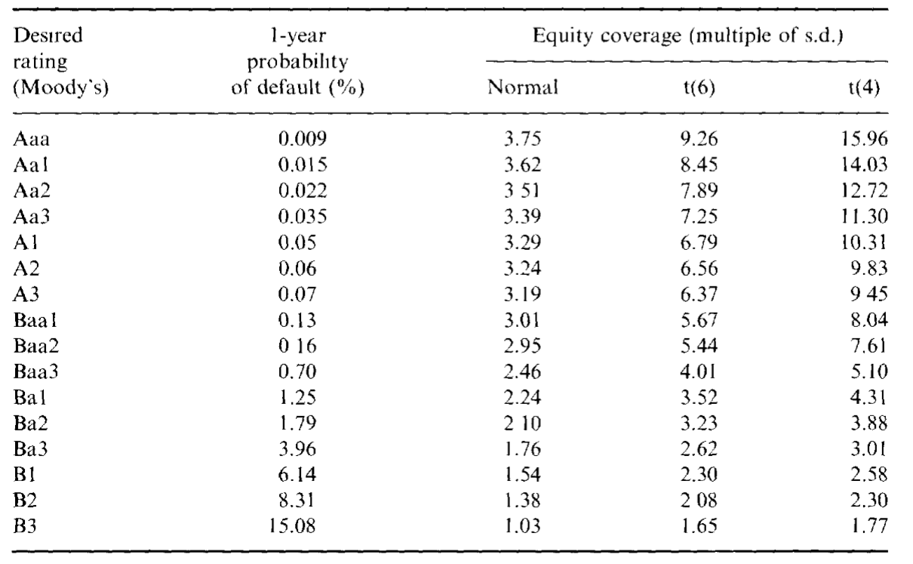
VaR Helps Determine The Appropriate Confidence Level
A bank can set the VaR confidence level in relation to the desired credit rating.

Slide 10
VaR Helps Determine The Appropriate Confidence Level
Equity coverage: the number of annual standard deviations necessary to achieve desired default probability.
Assume the market risk is such that the daily SD of profits and losses is $100 million. 252 trading days. Annual number = $100m * $√252$ = $1.6 billion
How much capital should the bank set aside to achieve an Aa2 credit rating?
Normally distributed: 3.51 * $1.6b = $5.6 billion
Student-t distributed (6 degrees of freedom): 7.89 * $1.6b = $12.6 billion

Slide 11
LTCM’s Risk Management Story
LTCM aimed for a level of risk no greater than that of us equities.
Daily dollar volatility: $4,700 * 0.15 / $√252$ = $44 million.
Indeed, LTCM claimed that its target daily volatility was $45 million around may 1998. The positions were allocated so as to maximize the expected returns subject to the constraint that the perceived risk was no greater than that of the stock market.
What’s wrong with this assumption?

Slide 12
LTCM’s Risk Management Story
First, it assumes that the volatility is constant, when in fact it can easily double in turbulent times.
Second, the distribution of profit and losses is unsymmetrical when dealing with credit risk, so the second moment is not so useful in this case.
Third, it is unlikely that the distribution tails could be described by a normal distribution.
Finally, use the same data to optimize a portfolio and compute its VaR results in biased risk forecasts.

Slide 13
LTCM’s Risk Management Story
We can see from empirical results that by 31st August, the portfolio had lost $1,710 million in 1 month only. Using the presumed $45 million daily (or $45m * $\sqrt{21}$ = $206 million monthly) standard deviation, this translates into a 8.3 ( = $1,710m / $206m) standard deviation event.
Assume normal distribution: occur once every 800 trillion years.
But if we use the true volatility, which turned out to be approximately $100 million, this was a 3.7 ( = $1,710m / ($100m * $\sqrt{21}$ )) standard deviation event.
Assume a distribution with fatter tails, student-t(4) distribution: occur once every 8 years.

Slide 14
An Example Of A Portfolio Optimization
A BAA-rated corporate bond and a 10-year Treasury note series portfolio.
Maximize a utility function: $U\left(w | μ,\sum{ }\right)=U\left(μ_{p, σ_{p}^{2}}\right)= μ_{p} −1/(2λ)σ_{p}^{2}$, where $λ$ is the risk tolerance of investors. This function reflects the trade off between $μ_{p}= w^{′}μ$and $σ_{p}^{2}=w^{′} \sum{ }w.$
So now the optimal positions in risky assets are given by $w= λ {\sum{ }}^{−1} μ$, with the remainder invested in the riskless asset.
Table in next slides shows a worked-out example.

Slide 15
An Example Of A Portfolio Optimization

Slide 16
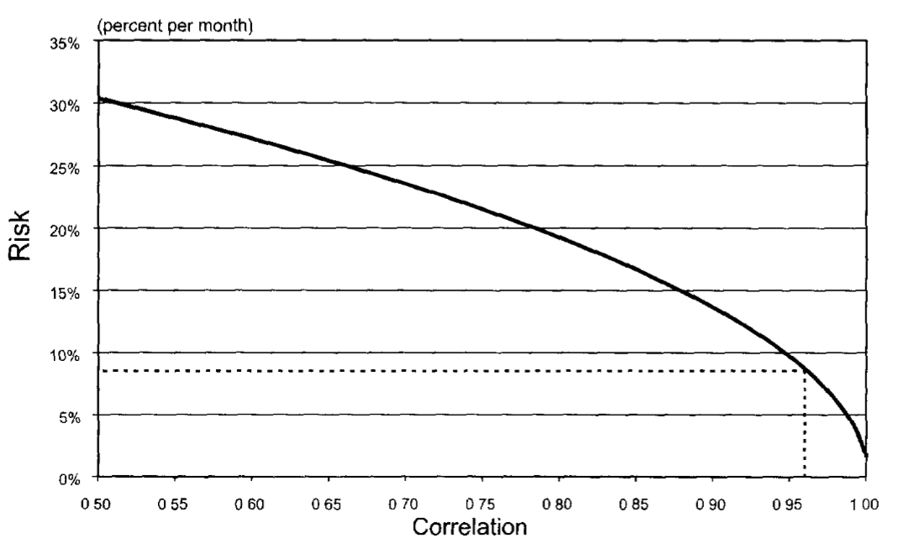
What’s Wrong With This Strategy?
The true correlation may change over time. We need stress testing.

Slide 17
What’s Wrong With This Strategy?
${vol}_{p}= √(w_{1}^{2}σ_{1}^{2}+ w_{2}^{2}σ_{2}^{2} −2ρw_{1}w_{2}σ_{1}σ_{2})$
When $ρ$ = 0.9654, volatility = 0.081, safety ratio = 1 / 0.081 = 12.3 this loss appears unlikely
When $ρ$ = 0.9, volatility = 0.1365, safety ratio = 1 / 0.1365 = 7.3
When $ρ$ = 0.8, volatility = 0.192, safety ratio = 1 / 0.192 = 5.2 the amount of investor equity can only cover a 5 standard deviation move

Slide 18
What’s Wrong With This Strategy?

Slide 19
What’s Wrong With This Strategy?

Slide 20
What’s Wrong With This Strategy?
When we extend this simple example to the much larger number of positions assumed by LTCM, it gets even worse. Because estimation risk increases with the number of parameters. The more parameters are estimated, the greater the chance that errors will interact with each other and create a misleading picture of risk.
The problem with traders trying to ’game’ a VaR system.

Slide 21
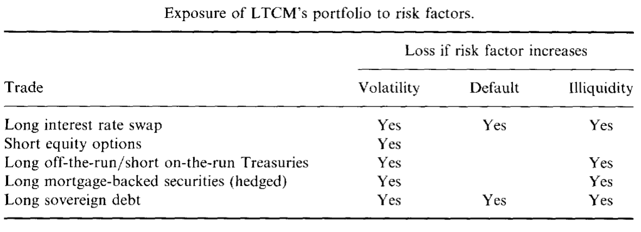
LTCM’s Risk Profile
LTCM failed because of its inability to measure, control and manage risk. The fact is, LTCM’s trades were rather undiversified.

Slide 22
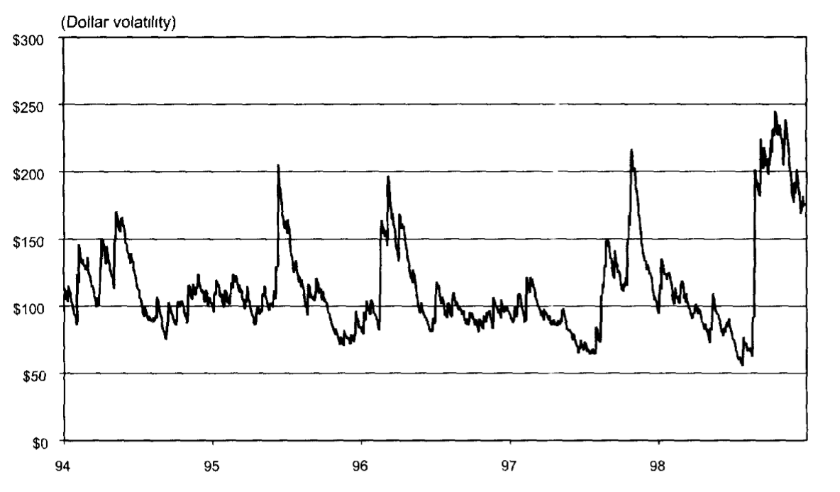
LTCM’s Risk Profile
When we combine the information on the exposure of the fund with the daily volatility of credit spreads (predicted based on exponential weighing, a standard method introduced by J.P. Morgan in 1994) to simulate the fund’s volatility, we get the graph below:

Slide 23
LTCM’s Risk Profile
LTCM is a good example of the biases in portfolio optimization. Only a few of the ‘convergence’ trades could truly qualify as arbitrage trades. For instance, in the case of long off the run and short on the run bond, the fund took bets on the convergence of the credit spread, but if things didn’t go as predicted, it would make a huge loss.
The portfolio was exposed to hidden risks. The typical profile of credit spread trades is to make small profits most of the time, but to take a big loss once in a while. This profile is akin to a short position in an option. To assess the possibility of catastrophic but rare events, one cannot focus on recent history only.
The LTCM portfolio was also exposed to liquidity risk.

Slide 24
Conclusion
“The fact that (modern financial engineering) failed does not mean that the science of risk management is wrong-headed; just that it is still an imperfect art in a world where the past holds lessons but provides few reliable precedents.”
------James Leach (1998), Chairman, House Banking and Financial Services Committee

Slide 25
What We Learned From LTCM
The danger of optimization biases, or ‘traders gaming the system’.
The danger of building measures of event risk based on very recent price data.
Based on traditional risk management models, it is important to account for asset and funding liquidity and the price impact of forced sales.
Make better use of stress testing. Look at worst-case scenarios.

Slide 26
What We Learned From LTCM
About convergence-arbitrage strategies:
---the strategy is fundamentally sound and that the events of 1998 was so unusual so as to be impossible to forecast. These events are not likely to happen again.
---these strategies are actually designed to take a big loss once in a while, like a short position in an option. They induced the fund to make undiversified and highly leveraged bets on more subtle risks such as credit risks, political risks or market disruptions. Such strategies are fundamentally dangerous and much riskier than measured by traditional risk management systems.

Slide 27
My Opinions
Pros:
A detailed description of the LTCM crisis
Better understanding of VaR
Why portfolio management is biased
Cons:
Doesn’t relate very well between VaR and the event

Slide 28
THANK YOU!

